Slide 1
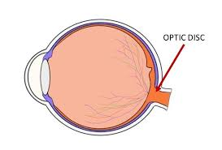
Optic disk
The optic disc is the entry point for the major blood vessels that supply the blood to retina. The optic disc in a normal human eye carries 1–1.2 million afferent nerve fibers from the eye towards the brain.
It is a vertical oval, with average dimensions of 1.76mm horizontally by 1.92mm vertically
Human Eye

Slide 2
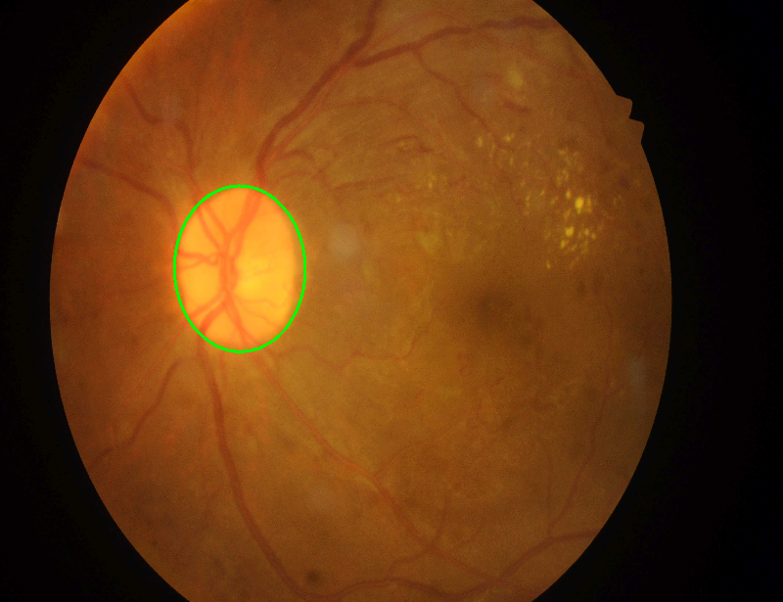
Optic disc detection
Algorithm:
1. Applied Median and Bilateral Filter on Gray image
2. Erode and Dilation of image
3. Created Mask { Mask is made after detecting bright pixels largest mask is the optic disk}
4 .Applied mask on image.

Slide 3
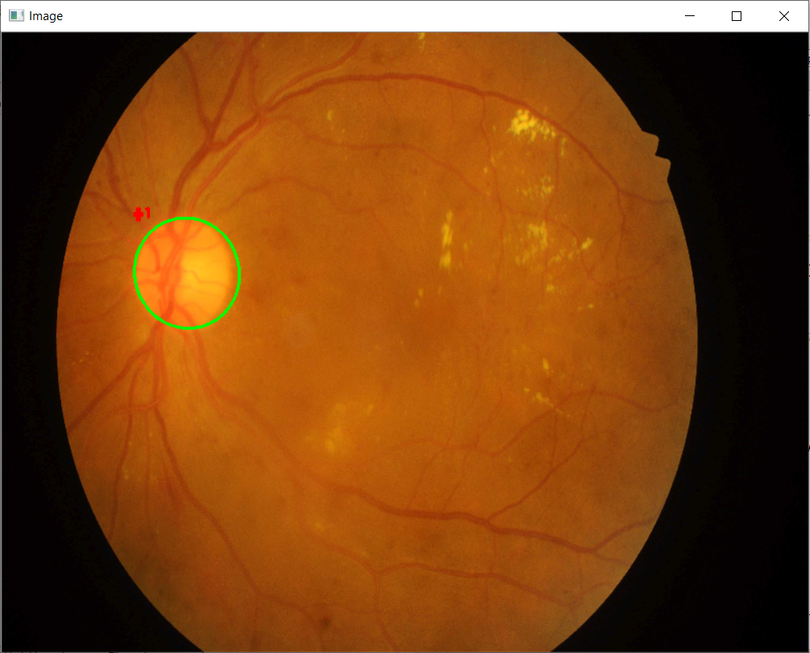


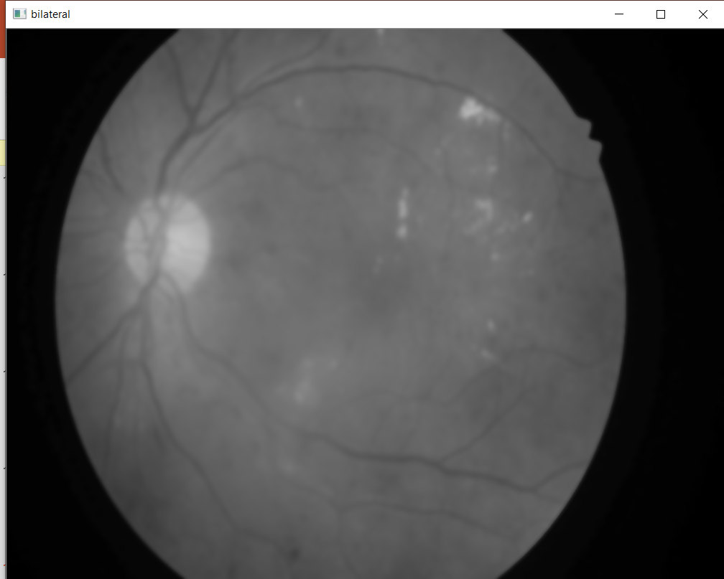

4. Apply Mask
1.Apply Filters
3. Create Mask
4.Dilation
operation
2. Thresholding
3.Erosion

